Slide 1

Amaz’d. (working title)
By Michael Tan-Sikorski
NEA E-PORTFOLIO

Slide 2
Log Of Progress for the project (in progress)
Log log log log

Slide 3


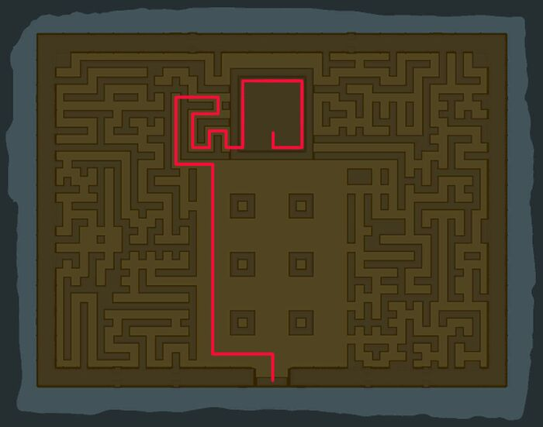

Project Background and problem investigated
When it came to creating a project, I knew I wanted to create something not only fun, but also testing problem solving skills.
-Due to the ever growing number of mindless games, riddled with advertisements, made for the sake of a profit only. I wanted to make sure my game would have puzzles, and test the users, so my game wouldn’t be mindless, and would engage the user for their entire playtime.
-I have always loved puzzle games that require you to come up with clever and fulfilling solutions, games such as portal 2 and breath of the wild come to mind, which shaped my childhood.
-This gave me a spark, in which I decided to create a game. I knew I wanted it to have infinite replay ability, so something that could be procedurally generated, to have infinite levels was desirable for me.

Slide 4

Objectives and Stakeholders
High level objectives (Objectives I must reach for the project to function and come out as the intended result):
-Moving character (with animations)
-Procedurally generated maze the character can move through
-character that can’t move through walls in the maze -music/sounds for game
-main menu screen with a nice UI for the player to interact with
-multiple levels for the user to play
-weapons for character and attacks -computer enemies with ai logic
Low-level objectives (Optional objectives that would improve my project/ add extra functionality):
-Powerups for the user
-Minigames within the maze
Target stakeholders:
-Players who love computer games
-Those who love problem solving and challenging their mind
-casual gamers who want to kill some time while also solving problems
Identified third-parties to bounce ideas off, and obtain feedback for this project:
-Theo Bahns (3D animation professional and computer game enthusiast)
-Kyrian Salas (Top student studying computer science)
-Daniel Tunyan (cyber centurion competition top 20 nationally)

Slide 5
Requirements (Hardware + Software)
Necessary Hardware for the project:
Necessary Software for the project:
-Computer and monitor (Computer needs a GPU in order to have graphical processing)
-Input/output devices (Keyboard, mouse, controller, speakers/headphones)
-Python 3.0.0 or higher installed on the computer
Min specs:
OS: Windows XP/Vista/7/8/10 (32-bit/64-bit)
Processor: Intel® Pentium® 4 2.0 GHz equivalent or faster processor
Memory: 512 MB RAM
Graphics: 1024 x 768 pixels or higher desktop resolution

Slide 6
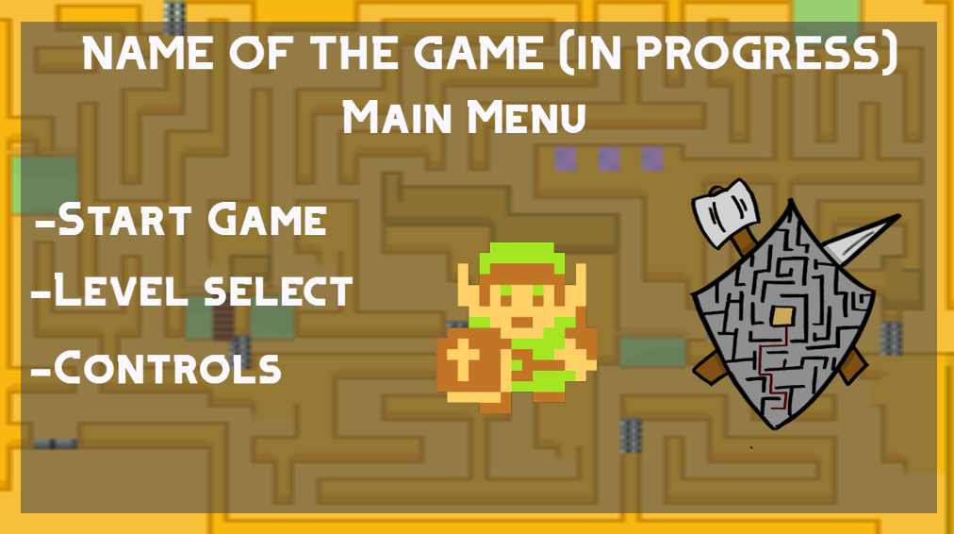
Prototype UI
Title:
-There will be the name of the game at the top, with the icon of the character, and the logo of the game.
-There will be 3 options to chose from in the main menu:
-Start Game
-Level Select
-Controls
Stakeholder feedback:
From stakeholder feedback, I could also add a “Quit Game” and “key binds/ settings” to the menu, or rename “controls” to “key binds/ settings” and add extra functionality if the user selects that option.

Slide 7
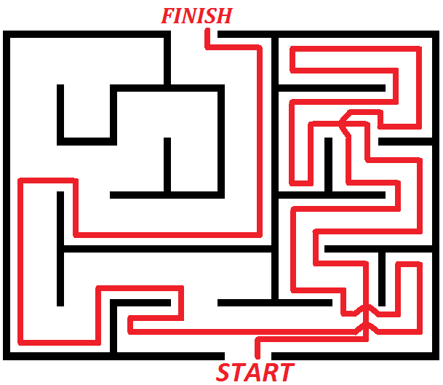
Maze algorithms that could be used
As I know I want to create a procedurally generated maze, I researched as many maze algorithms as I could, to decide on one that would work the best for my project:
-Depth first algorithm
-Randomized Prims algorithm
-Binary tree algorithm
-Sidewinder algorithm
-backtracking algorithm
-A* algorithm (search algorithm)
How I will go about coding this:
I now need to decided what language, and how to code this project. I decided to use python, and learn the Pygame module, that is built specifically for game design. I will start to learn how to use this module as the first step for how to start to code my project.

Slide 8
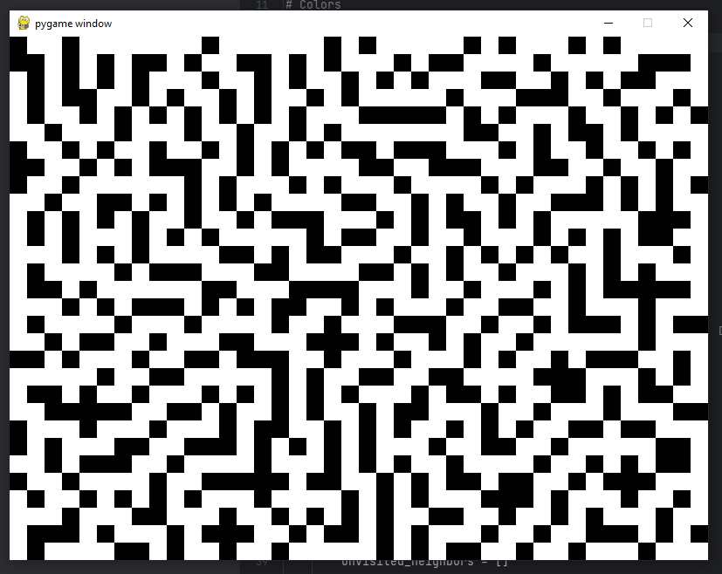
The Depth-First Algorithm
I decided to look a bit deeper into one of the procedural maze-creating algorithms, the depth-first algorithm:
The depth-first algorithm explores as far as possible along each branch before backtracking. The algorithm starts at a node, and “explores” as deeply as possible.
It starts at a node, and marks it as “visited”.
It explores adjacent unvisited nodes, and marks them as visited when it travels to one.
It recursively repeats this process, until there is a node with no unvisited neighbors. It then backtracks to the last node, and checks that for adjacent unvisited nodes.
The program terminated once all nodes have been visited, and you have your maze.
Picture of a basic depth-first maze algorithm on python using Pygame

Slide 9
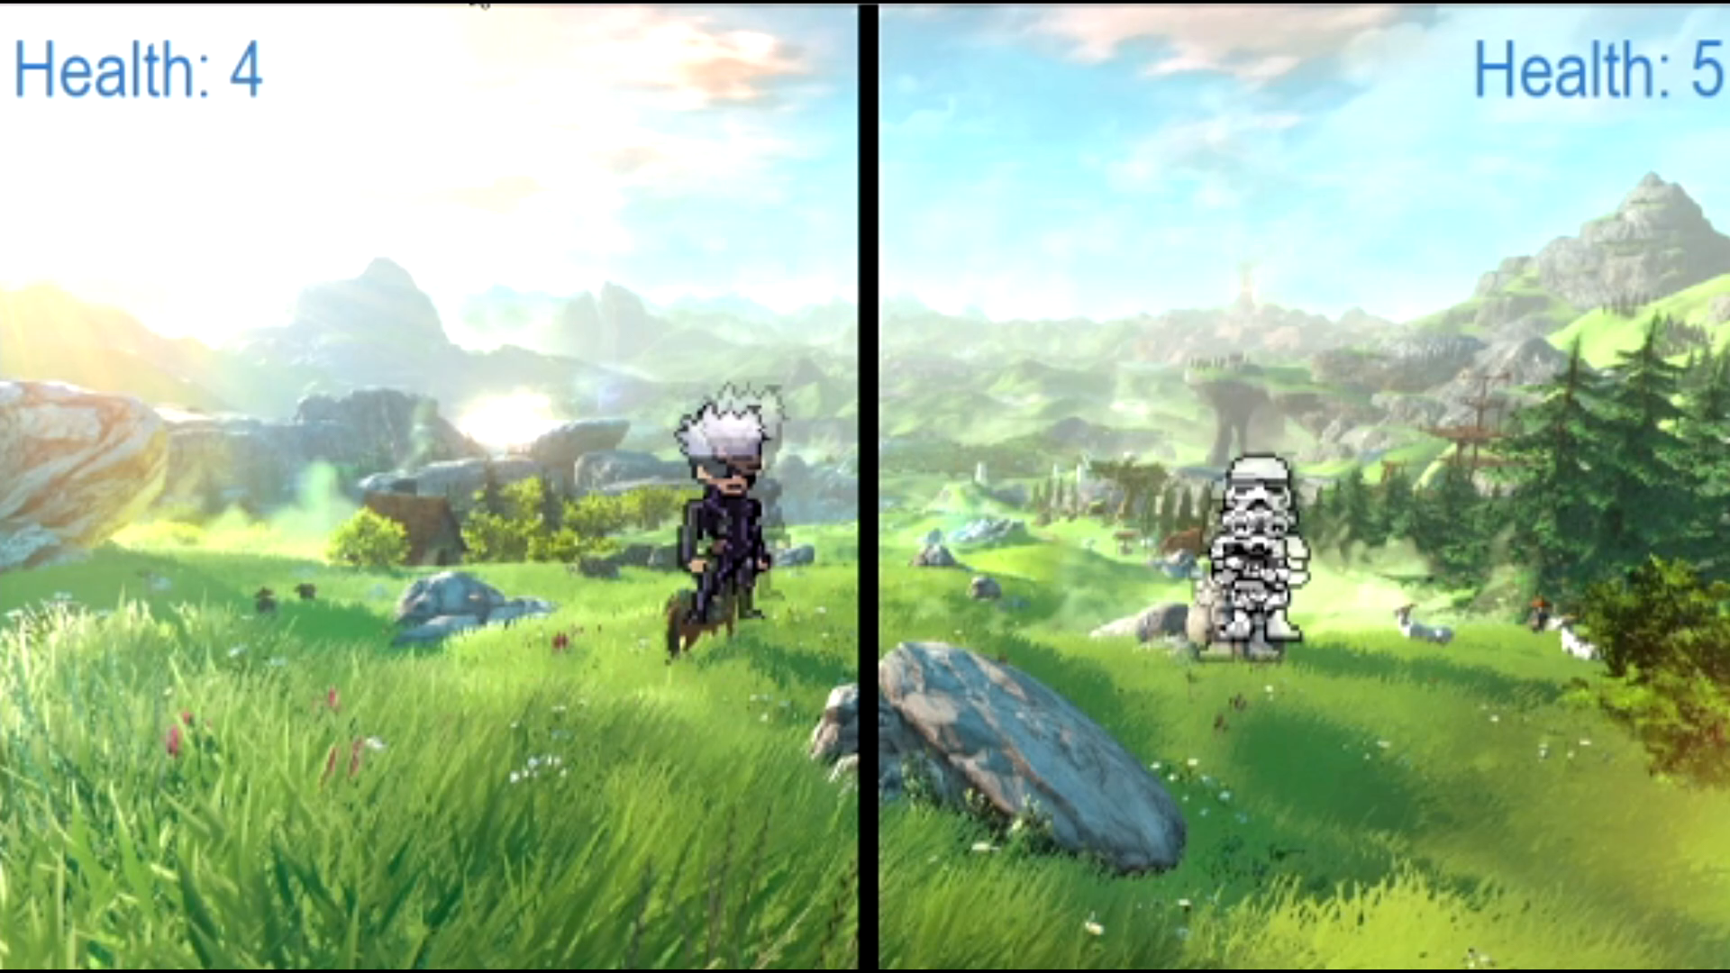
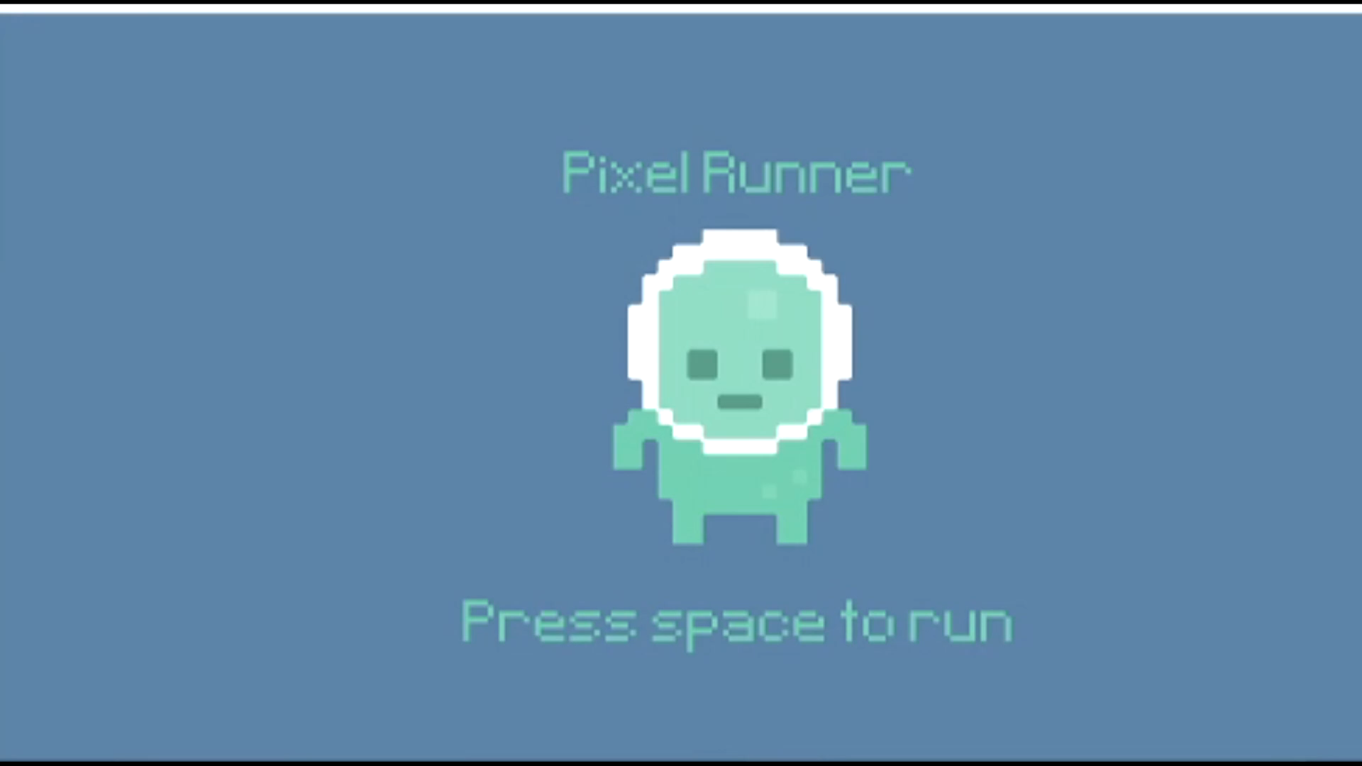
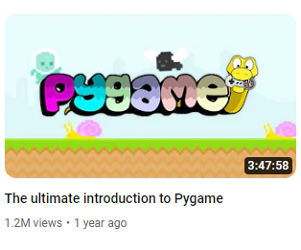
Learning Pygame
What I've learnt:
-I followed two tutorials on the basics of Pygame, in order to get a good grasp on how it works.
First, “Tech With Tim’s” Pygame for beginners, in which I learnt the fundamentals, and then Clear Codes “The ultimate introduction to Pygame”, which taught me how to use the “Sprite” class, which is vital for object-oriented programming in Pygame.
Games made by using both tutorials

Slide 10
Thanks for Watching, I hope you were Amaz’d.

Slide 11
Template Slide
Title:
-Text
Title:
-Text

